Slide 1
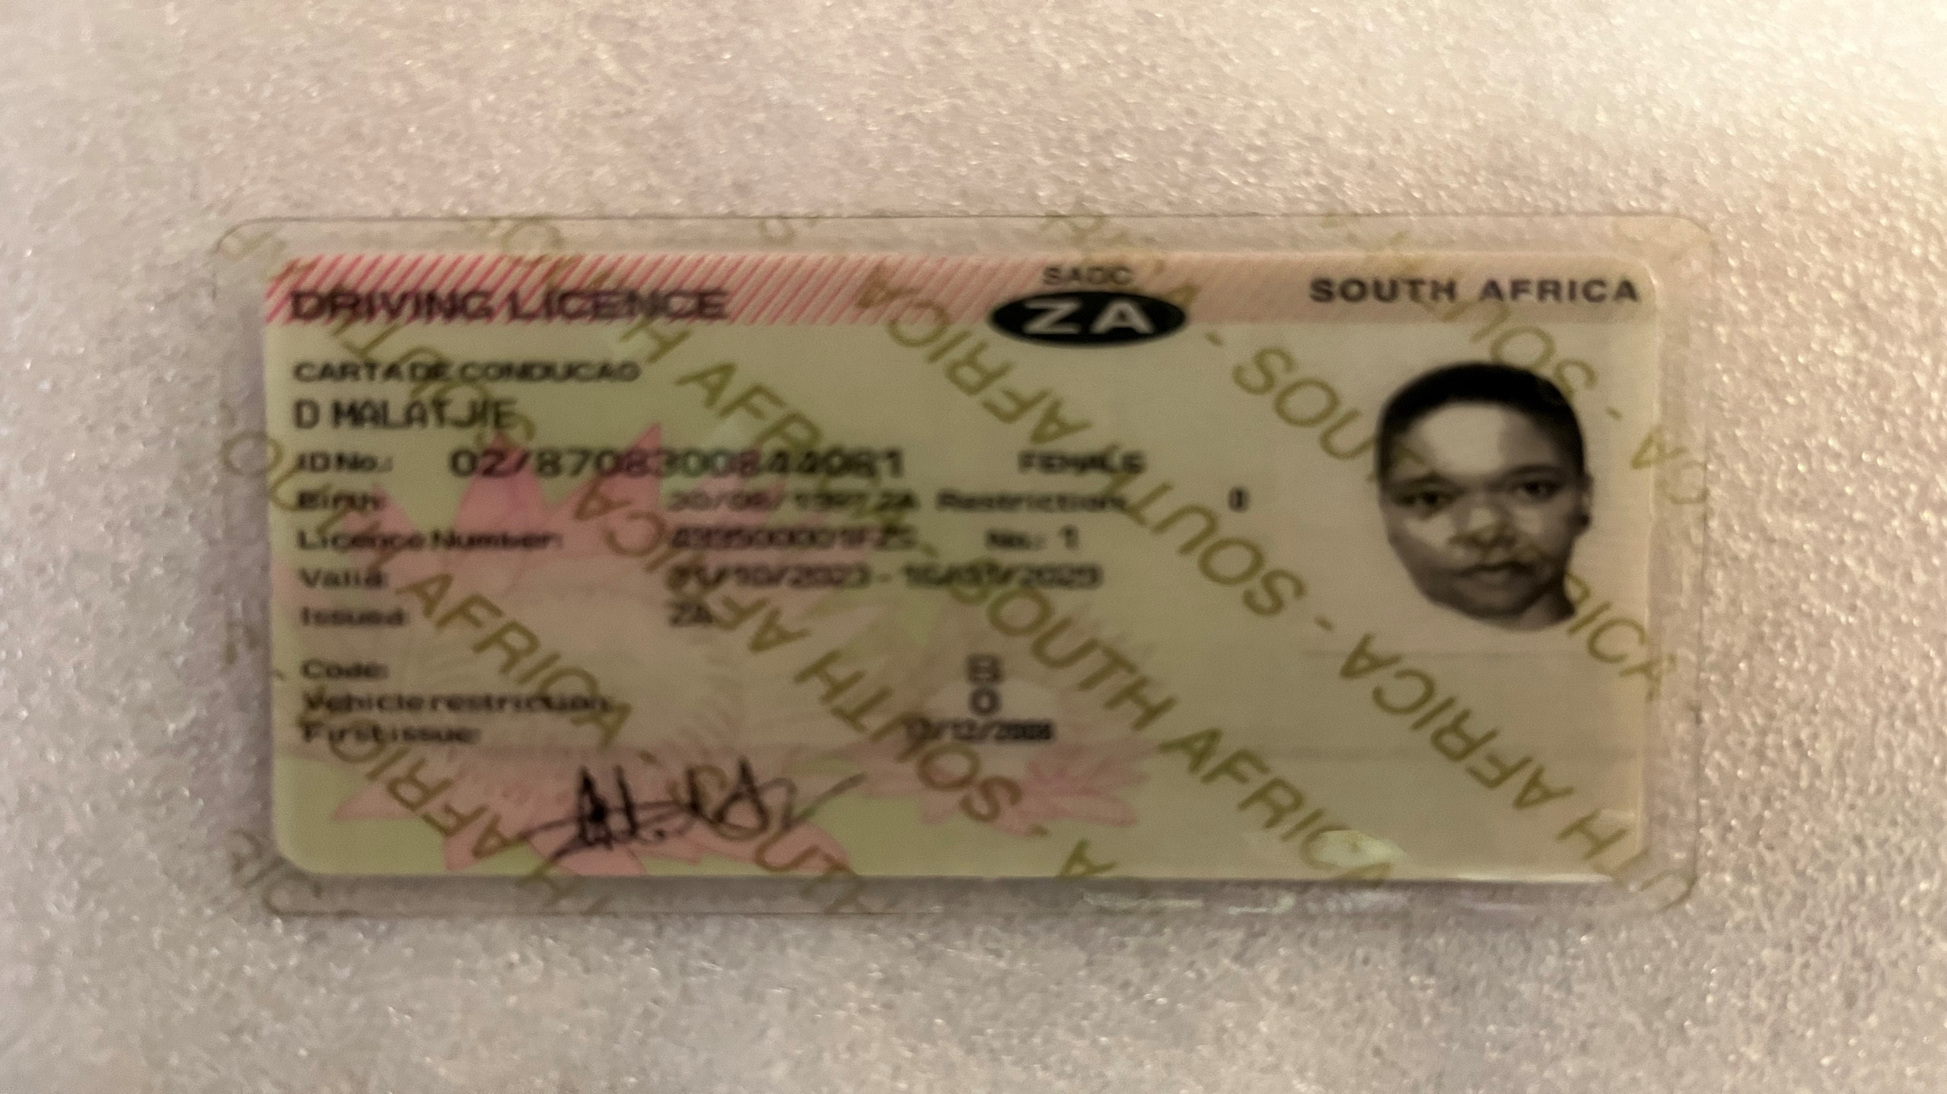
Identity Verification – Dineo Malatjie
Notes:
Hello, name is Dineo Malatjie and I’m here to present my capstone pitch which I worked on on my own. I had problems getting the camera to focus on my ID while holding it up, so I’ve attached a photo of it instead.

Slide 2
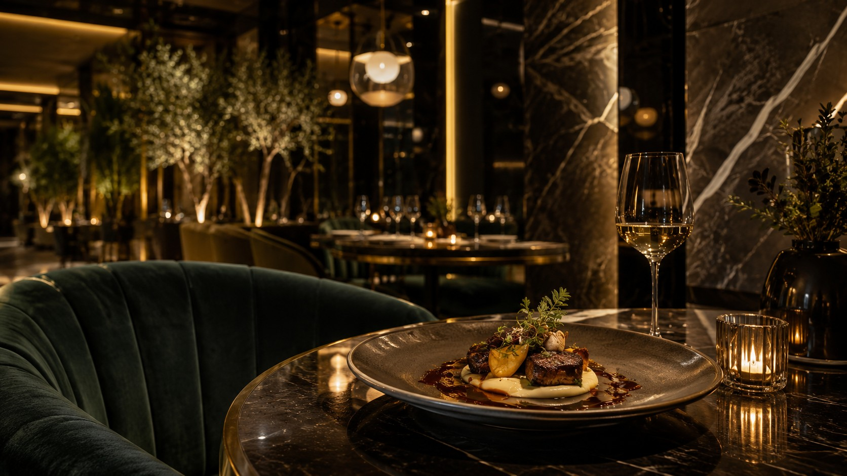
CAFÉ FAUSSE
FINE DINING & SEASONAL ELEGANCE
Restaurant Platform
Full-stack web application design and implementation
Dineo Malatjie | MSc Artificial Intelligence Engineering | 2026
Notes:
[Sources]
- Café Fausse hero-banner.jpg, user-provided AI-generated project asset.

Slide 3
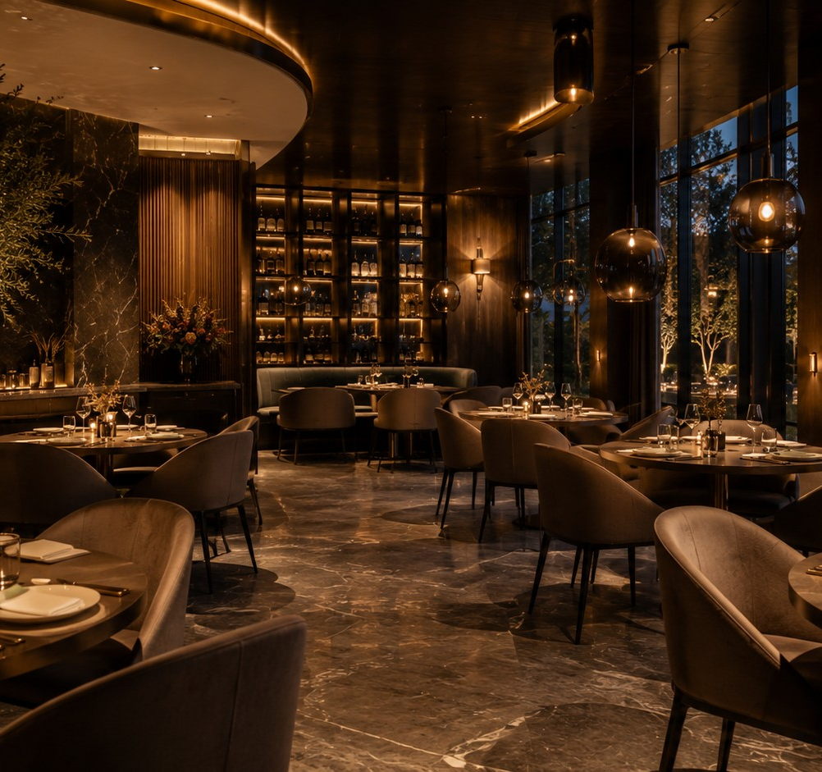
CAFÉ FAUSSE
FINE DINING & SEASONAL ELEGANCE
PROJECT SUMMARY
A refined digital experience,
built as a working platform
Café Fausse is a responsive full-stack restaurant website connecting a React customer interface, Flask APIs and PostgreSQL data. Customers can explore the brand, browse a database-backed menu, reserve a table, order for collection, review a cart and checkout summary, and receive order confirmation.
Open GitHub repository ↗
Open local website ↗
CAFÉ FAUSSE RESTAURANT PLATFORM
02
Notes:
[Sources]
- Project summary derived from Pasted text(2).txt, user-provided report.
- Café Fausse Interior.jpg, user-provided AI-generated project asset.
- GitHub repository: https://github.com/dineom-arch/Quantic_Web_App_Design_Project_Dineo_Malatjie
- Local website: http://localhost:3000/

Slide 4
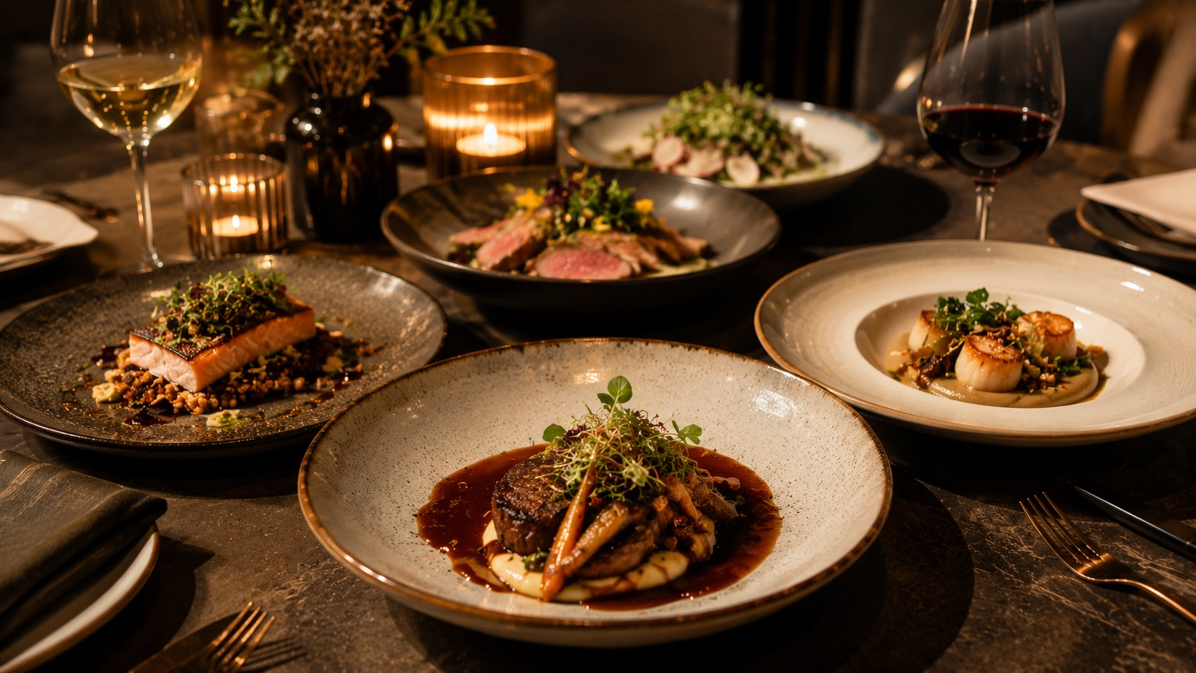
01
Customer
Experience
A premium interface that supports discovery, booking and ordering.
Notes:
[Sources]
- Café Fausse Dishes.jpg, user-provided AI-generated project asset.

Slide 5
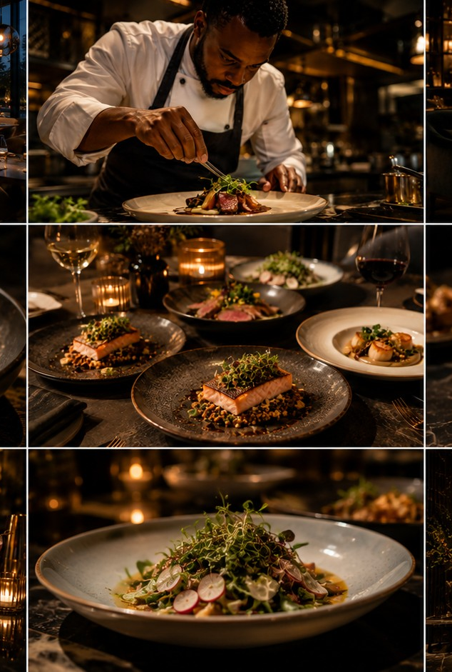
CAFÉ FAUSSE
FINE DINING & SEASONAL ELEGANCE
One journey connects inspiration to collection
The completed build moves beyond a brochure website and supports the customer’s full path through the restaurant experience.
01
Discover
Homepage specials, restaurant story and gallery visuals establish the brand.
02
Plan
Customers browse live menu content and complete a database-backed reservation.
03
Order
Click & Collect adds items to a persistent cart with quantity controls.
04
Confirm
Checkout shows order details and totals before pay-on-collection confirmation.
CAFÉ FAUSSE RESTAURANT PLATFORM
04
Notes:
[Sources]
- Functional journey derived from Pasted text(2).txt, user-provided report.
- Café Fausse Gallery.jpg, user-provided AI-generated project asset.

Slide 6
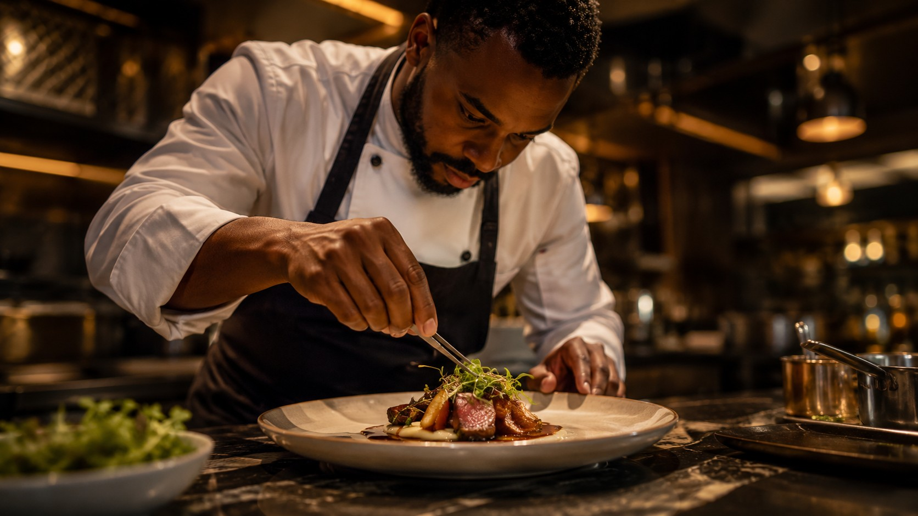
02
Engineering
Foundation
A modular full-stack architecture keeps presentation, logic and data concerns separate.
Notes:
[Sources]
- Café Fausse Chef.jpg, user-provided AI-generated project asset.

Slide 7
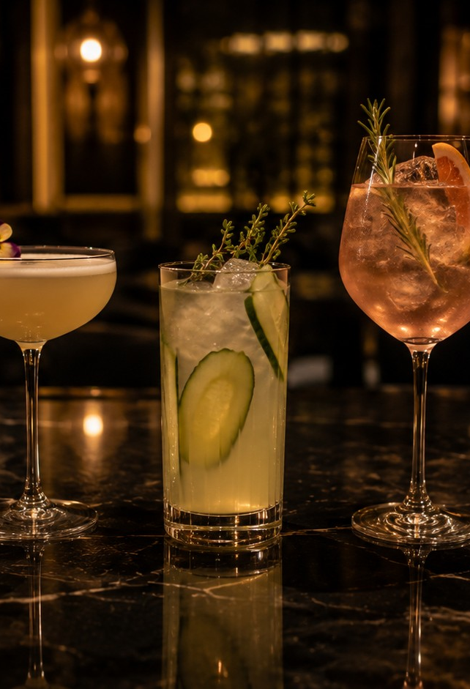
CAFÉ FAUSSE
FINE DINING & SEASONAL ELEGANCE
Three layers keep the solution maintainable
The implementation separates the customer experience from application logic and persistent data. This reduces coupling and creates a practical foundation for future features.
REACT
FLASK
POSTGRESQL
Presentation
Application
Data
Responsive pages, reusable components, navigation, cart and checkout state.
REST APIs, validation, authentication, business logic and database access.
Menu items, reservations, orders, order items, subscribers and staff records.
CAFÉ FAUSSE RESTAURANT PLATFORM
06
Notes:
[Sources]
- Architecture description derived from Pasted text(2).txt, user-provided report.
- React documentation: https://react.dev/
- Flask documentation: https://flask.palletsprojects.com/
- PostgreSQL documentation: https://www.postgresql.org/docs/
- Café Fausse Cocktails.jpg, user-provided AI-generated project asset.

Slide 8
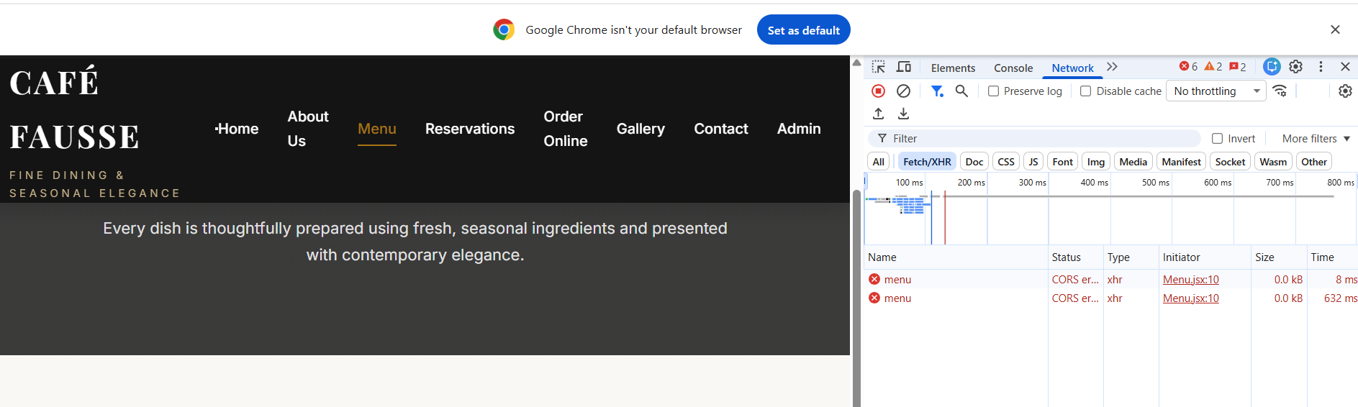
CAFÉ FAUSSE
FINE DINING & SEASONAL ELEGANCE
LIVE DEMONSTRATION
See the platform in action
▶
INSERT SCREEN RECORDING HERE
Suggested flow: homepage → menu → reservation → Click & Collect → checkout → confirmation
CAFÉ FAUSSE RESTAURANT PLATFORM
07
Notes:
[Sources]
- Café Fausse website screenshot supplied by the user.
- Demo flow derived from Pasted text(2).txt, user-provided report.

Slide 9
CAFÉ FAUSSE
FINE DINING & SEASONAL ELEGANCE
References
1
Quantic (2026). Café Fausse Software Requirements Specification.
5
Vite (2026). Next Generation Frontend Tooling.
9
OpenAI (2026a). ChatGPT project-development responses.
2
Meta (2026). React documentation.
6
Microsoft (2026). Visual Studio Code documentation.
10
OpenAI (2026b). AI image-generation responses.
3
Pallets Projects (2026). Flask documentation.
7
GitHub (2026a). GitHub platform.
11
OpenAI (2026c). ChatGPT report-alignment and revision responses.
4
PostgreSQL Global Development Group (2026). PostgreSQL documentation.
8
GitHub (2026b). GitHub Copilot documentation.
CAFÉ FAUSSE RESTAURANT PLATFORM
08
Notes:
[Sources]
- Reference list reproduced and condensed from Pasted text(2).txt, user-provided report.

Slide 10
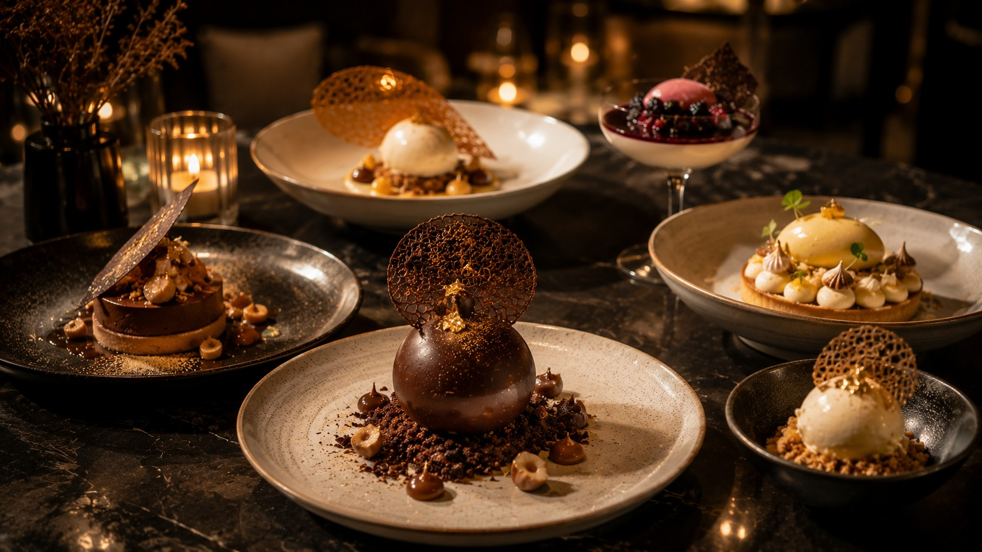
Thank You
Questions & discussion
CAFÉ FAUSSE · FINE DINING & SEASONAL ELEGANCE
Notes:
[Sources]
- Café Fausse Desserts.jpg, user-provided AI-generated project asset.

